Slide 1
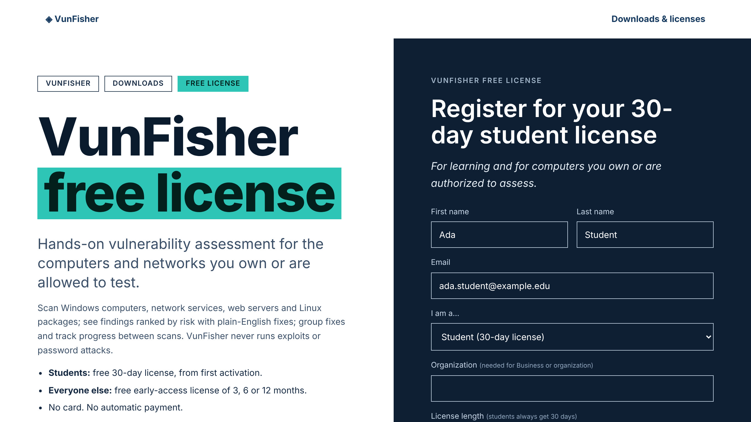
VunFisher: request and install
Request your free 30-day student license, install VunFisher on Windows, a virtual machine or a Mac, and activate it
Notes:
Send this deck to students before the course. By the end every student has VunFisher installed and an active 30-day license. Scan only computers you own or are explicitly authorized to assess.

Slide 2
Six steps from request to an active license
1
2
3
4
5
6
Request
Confirm
Install
Create account
Activate
Check
Fill in the student form
Click the link we email
Run INSTALL.vbs
Your own username and password
Enter the emailed code
License shows ACTIVE
Time needed: about 20 minutes. You need a Windows 10 or 11 (64-bit) computer or virtual machine, an email inbox you can open now, and administrator rights on that computer.
Notes:
Walk through the six steps. Steps 1 and 2 happen on the website, steps 3 to 6 in the app. The activation code usually arrives within a few minutes after the email is confirmed.

Slide 3
Before you start: pick your computer
PC
VM
Mac
Windows laptop or desktop
Virtual machine
MacBook
64-bit Windows 10 or 11. Suggested 4 GB RAM and 2 GB free disk. Install directly.
VMware, VirtualBox or Hyper-V with Windows 10/11 64-bit. Suggested 2 CPUs, 4 GB RAM, 60 GB disk. Use Bridged networking to scan other lab computers.
No macOS version yet. Install Windows in VMware Fusion, Parallels or UTM (Windows 11 on Arm on M1 to M4 Macs, not yet validated by TX Cyber).
Rule for this course: only scan computers you own or that your instructor has authorized in writing.
Notes:
Most students will install directly on Windows. Mac users must create a Windows virtual machine first; that takes longer, so start it before class if possible.

Slide 4
Part 1: Get your free student license
txvf.tinkextra.com/quote?for=student

Slide 5
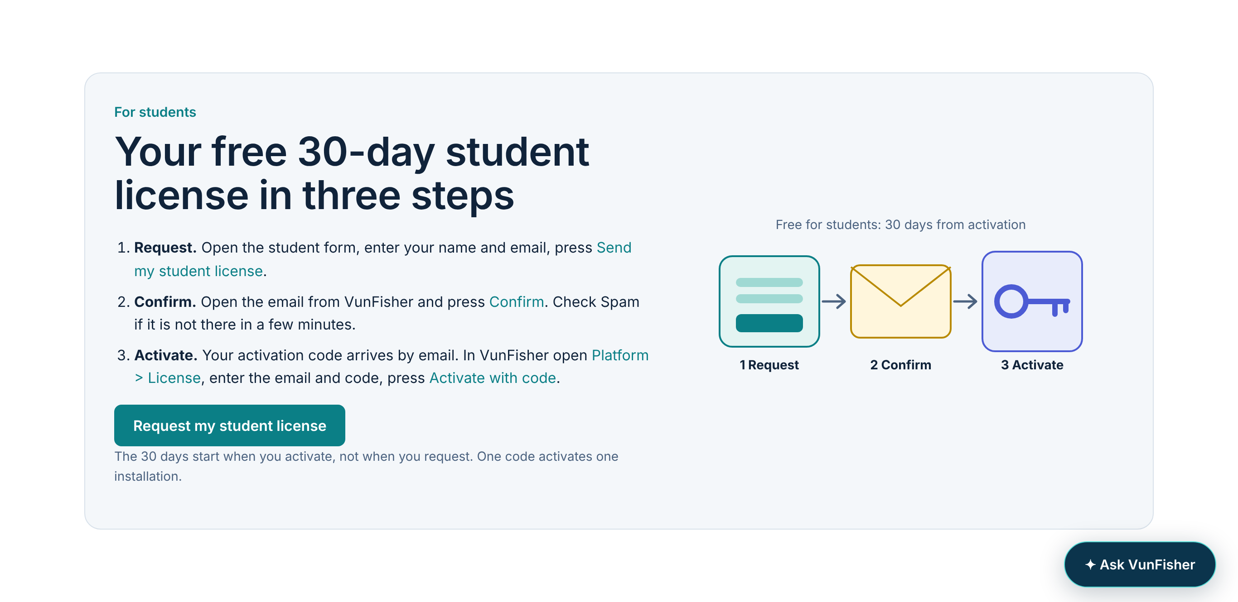
Step 1: Open the student request form
1
Go to the downloads page
txvf.tinkextra.com/overview/downloads.html
2
Find "For students"
It is near the top of the page
3
Click "Request my student license"
Or go straight to txvf.tinkextra.com/quote?for=student
Notes:
Share the direct link in the course chat: txvf.tinkextra.com/quote?for=student. It opens the request form with Student already chosen.

Slide 6
Step 2: Fill in the form and press Get started
1
First and last name
As your instructor knows you
2
Email
An inbox you can open now
3
I am a... Student
Students always get 30 days
4
Tick the first box
You will only scan authorized computers
5
Press Get started
You will see your reference number
Notes:
Common mistakes: leaving "I am a..." on "Choose one" gives the message "Role is required". A typo in the email means the code never arrives; students can simply send the form again with the right address.

Slide 7
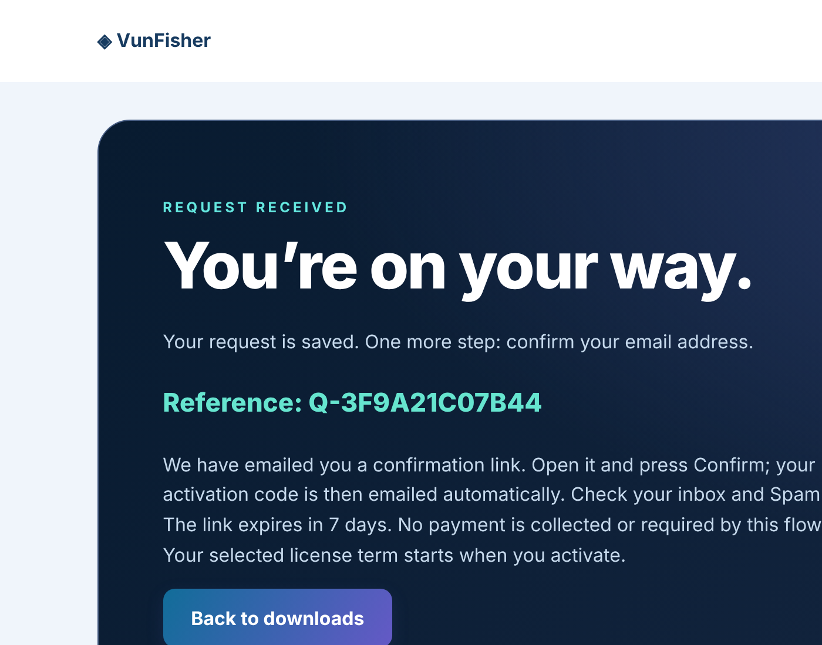
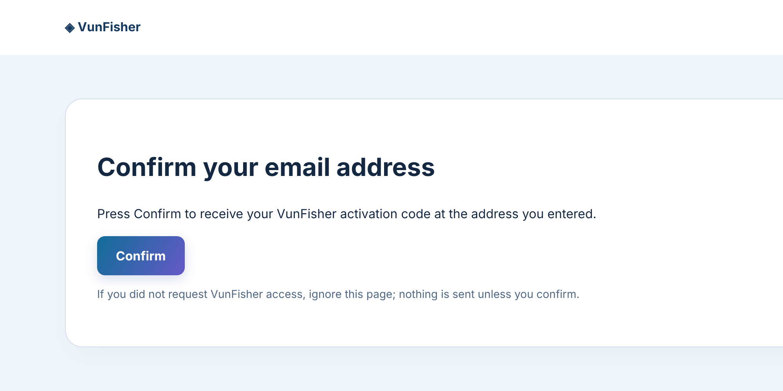
Step 3: Confirm your email
After Get started: note your reference
Open the VunFisher email and press Confirm
Check Spam if it has not arrived in a few minutes. The link works for 7 days.
Notes:
After Confirm, the activation code is emailed automatically. Students keep that email open for step 6.

Slide 8
Part 2: Install VunFisher
About 5 minutes. Python and everything else is included.

Slide 9
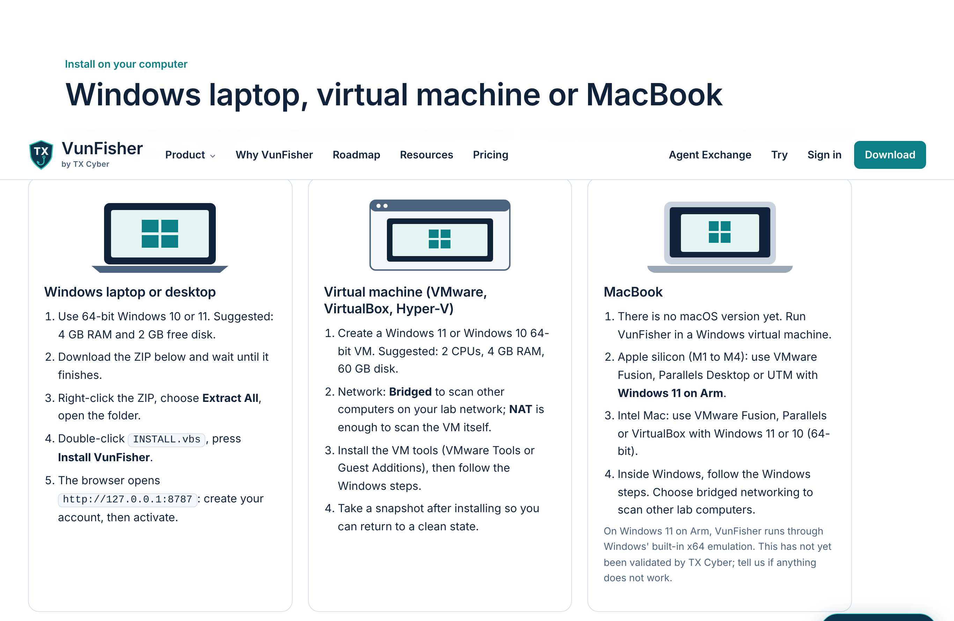
Step 4: Download and install
1
Download the ZIP
Downloads page > Download VunFisher for Windows; wait until it finishes
2
Extract All
Right-click the ZIP > Extract All > open the folder
3
Run INSTALL.vbs
Double-click it and press Install VunFisher
4
Wait for the browser
It opens 127.0.0.1:8787 by itself
Notes:
Do not run the installer from inside the ZIP; extract it first. If Windows SmartScreen asks, choose More info then Run anyway only if the file came from txvf.tinkextra.com. The package hash is published on the downloads page for anyone who wants to check it.

Slide 10
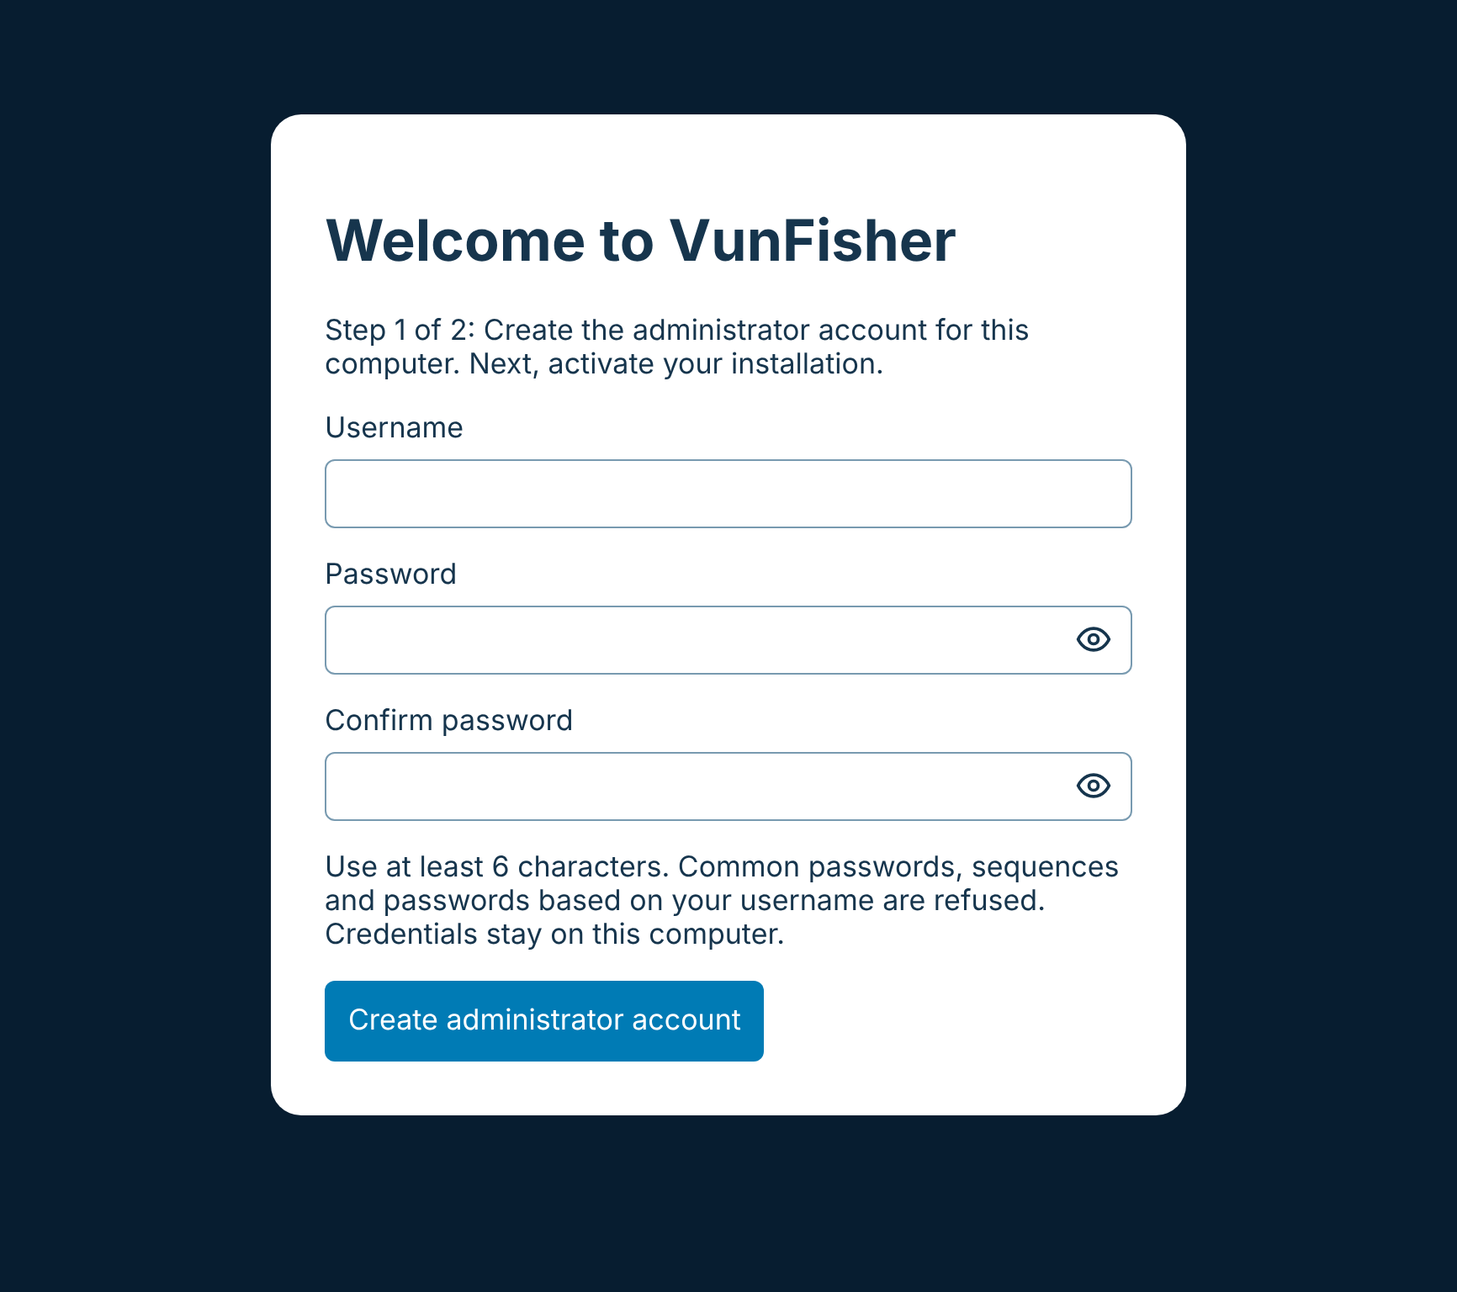
Step 5: Create your VunFisher account
1
Choose a username
At least 3 characters
2
Choose a password
At least 6 characters; common passwords are refused
3
Type it again and create the account
This account lives only on this computer
This is not your website account. Write the username down somewhere safe; never share the password.
Notes:
If a student forgets the username or password later, slide "Forgot your username or password?" shows the self-service reset.

Slide 11
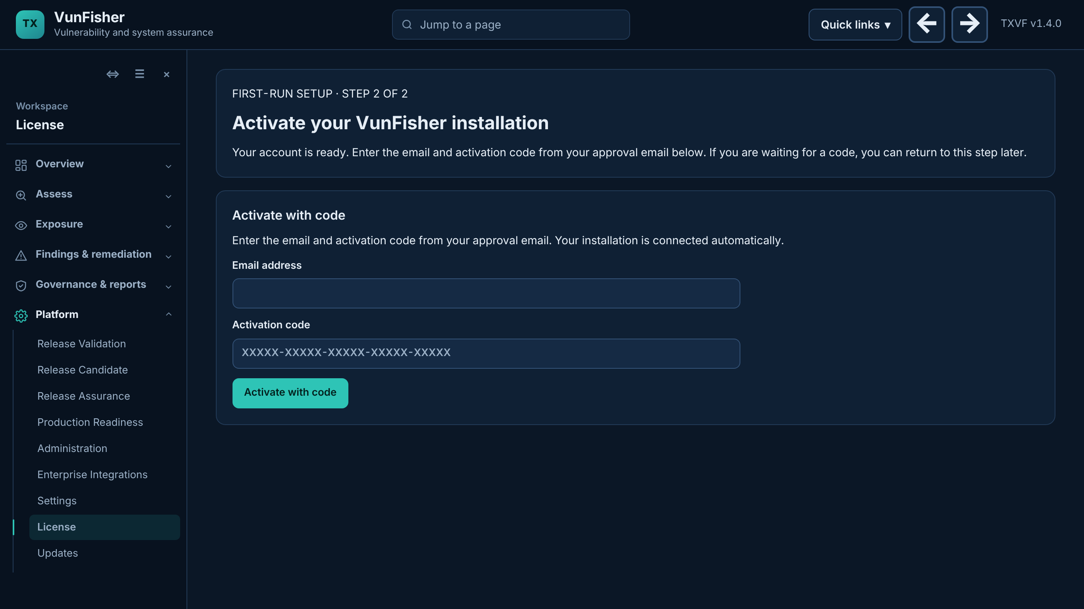
Step 6: Activate with your emailed code
1
Open the activation email
Subject: Your VunFisher activation code
2
Enter the same email address
The one you used on the form
3
Enter the activation code
Five groups of five characters
4
Press Activate with code
Your 30 days start now
Notes:
One code activates one installation. A code not used within 30 days expires; request a new one. Codes are private: do not post them in chat.

Slide 12
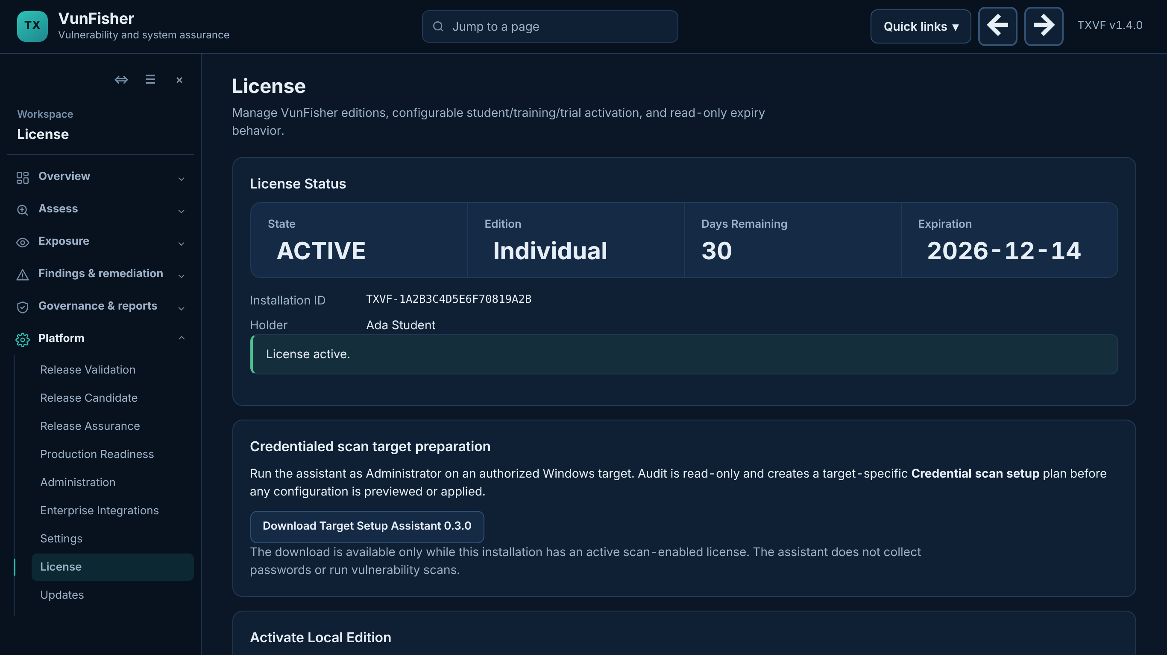
Step 7: Check your license is active
You should see
State: ACTIVE
Edition: Individual
Days remaining: 30
Platform > License. The same page has the Target Setup Assistant download used in the training.
Notes:
If the state is not ACTIVE, check the email address matches the request and that the computer has internet access.

Slide 13
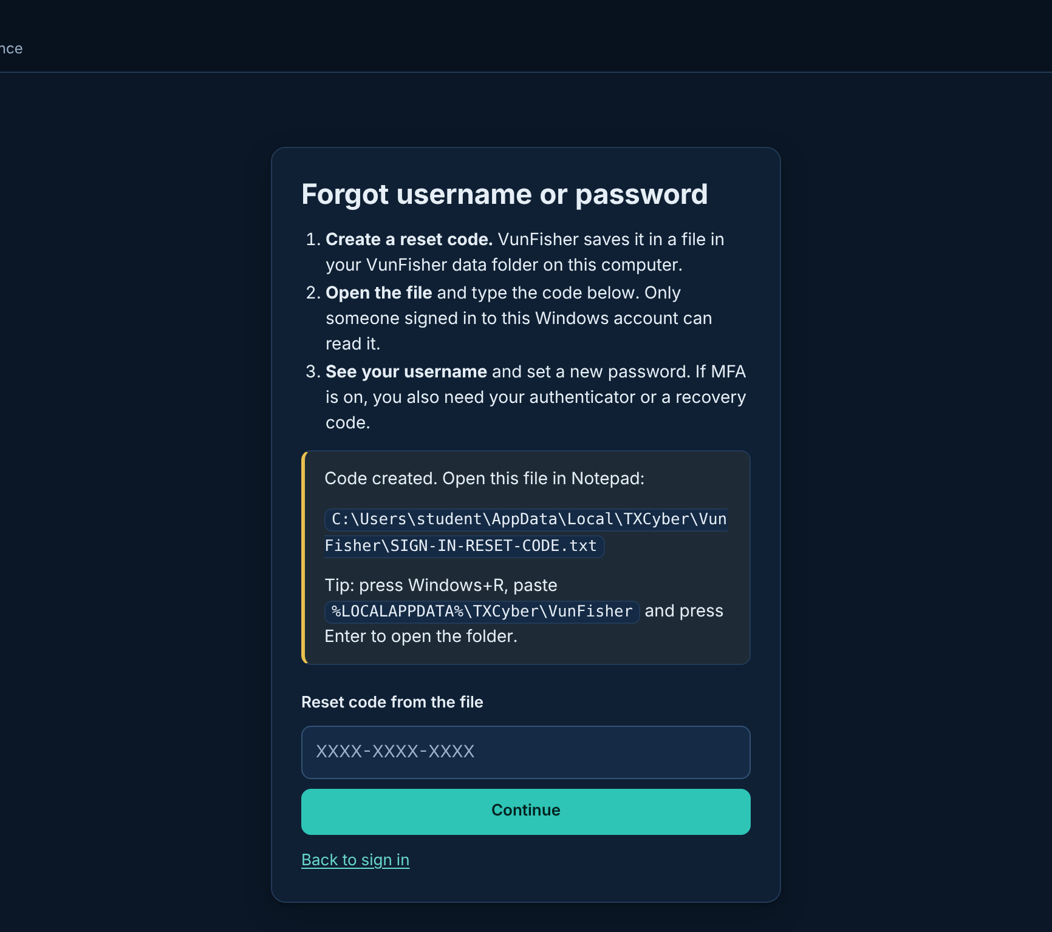
Forgot your username or password?
1
On the sign-in page
Click "Forgot username or password?"
2
Create a reset code
VunFisher saves it in a file on your computer
3
Open the file
%LOCALAPPDATA%\TXCyber\VunFisher\SIGN-IN-RESET-CODE.txt
4
Type the code
You see your username; set a new password (6+ characters)
Notes:
The code works once and expires after 15 minutes. If MFA is turned on, the authenticator code or a recovery code is still needed. Press Windows+R and paste %LOCALAPPDATA%\TXCyber\VunFisher to open the folder.

Slide 14
Quick fixes
No email arrived
Check Spam. Wait 5 minutes. Send the form again with the correct address.
"Role is required"
Choose Student under I am a...
Browser did not open after install
Open the TX VunFisher shortcut, or go to http://127.0.0.1:8787
Code says it is used
One code, one installation. Request a new code for a second computer.
Forgot password
Sign-in page > Forgot username or password
SmartScreen warning
More info > Run anyway, only for the ZIP downloaded from txvf.tinkextra.com
Notes:
Keep this slide on screen while students install.

Slide 15
Links
VunFisher website: https://txvf.tinkextra.com/overview/
Downloads (app, SHA-256, SBOM): https://txvf.tinkextra.com/overview/downloads.html
Student license request: https://txvf.tinkextra.com/quote?for=student
Every published build: https://txvf.tinkextra.com/overview/roadmap.html#release-history
Your VunFisher app (after install): http://127.0.0.1:8787
Next: the training deck "VunFisher credentialed scanning" prepares a target computer and runs the first scan.

Slide 16
VunFisher is installed
License active · username and password saved safely · bring this computer to the training
Notes:
Students should confirm Platform > License shows ACTIVE before the training session.

