Slide 1

VunFisher
Product position and controlled beta guide
From scan readiness to proof of closure
Current capabilities, tester workflow and official resources
September 2026
Notes:
VunFisher positioning deck. Product state: controlled Windows beta. The short line is a positioning hypothesis under beta validation.

Slide 2
The problem after vulnerability detection
Established platforms already scan, prioritize and support remediation
The unresolved job
Where context commonly breaks
How does a resource-constrained team safely obtain trustworthy credentialed evidence, understand coverage, assign action, prove the fix, document accepted risk and produce a defensible record without rebuilding the story across several tools?
Target preparation and authentication
Finding evidence and confidence
Ownership and remediation work
Retest and risk decisions
Audit and management reporting
VunFisher focuses on continuity across this entire evidence chain.
TX Cyber / VunFisher · Controlled beta
02
Notes:
Competitor baseline sources: Tenable Vulnerability Management and Rapid7 InsightVM Remediation Projects. Links appear on the final slide.

Slide 3
VunFisher's focused position
A bounded promise for the controlled Windows beta
VunFisher helps Windows-focused teams without a large security stack turn authorized system evidence into verified remediation and audit-ready decisions by guiding credentialed-scan setup and preserving the chain from finding to owner, fix, retest, risk acceptance and report in one workspace.
The product competes first on
The current claim excludes
Guided Windows target readiness
Transparent authentication and coverage evidence
Finding provenance and explainable risk
Documented ownership, remediation and retest
Audit-oriented evidence exports
Internet-scale scanning
Production multi-tenant SaaS and SSO
Broad Linux, cloud and container coverage
Live enterprise connectors
Unproven claims of superiority or complete security
TX Cyber / VunFisher · Controlled beta
03
Notes:
Capability boundaries match VUNFISHER_BETA_PRODUCT_REVIEW.md and VUNFISHER_ENTERPRISE_GAP_ASSESSMENT.md.

Slide 4
Assessment-to-assurance evidence chain
Every stage retains the evidence needed for the next decision
1
2
3
4
5
6
Prepare
Assess
Decide
Act
Verify
Report
>
>
>
>
>
Target audit and ordered setup guidance
Authorized collection, authentication and coverage
Evidence, confidence, severity and TXRS
Owner, due date, fix, POA&M or risk decision
Comparable retest and recorded disposition
Technical, executive and authorization evidence
Coverage failures stay visible. A missing check never becomes a clean result.
TX Cyber / VunFisher · Controlled beta
04
Notes:
Process represents the current VunFisher operating model. Planned automation must preserve authorization and evidence provenance.

Slide 5
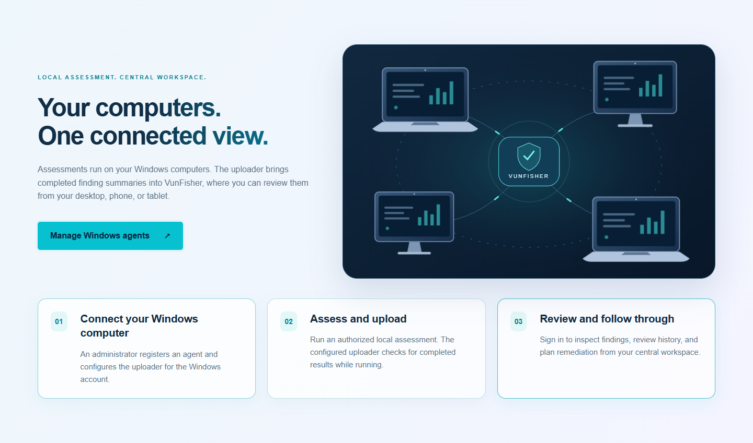
Current Windows beta
Capabilities ready for controlled testing
Assessment
Local Windows and authorized private-network checks
Credentialed WinRM assessment and preflight
Target Setup Assistant guidance
55 built-in TXVF Plugins
Evidence and action
Evidence-first correlation and vulnerability intelligence
TXRS prioritization and finding history
Ownership, remediation, retest, POA&M and risk acceptance
Reports and authorization-oriented exports
Controlled beta means the workflows are packaged and verified, while field acceptance remains necessary.
TX Cyber / VunFisher · Controlled beta
05
Notes:
Current product review and build 2026092702. This slide does not claim certification or complete coverage.

Slide 6
Current limits and enterprise direction
Planned work remains separate from the beta promise
Current limits
Prioritized direction
Installer is not Authenticode signed
Linux assessment remains partial
Single-organization deployment model
No live outbound enterprise connectors
No cloud, container, SBOM or web DAST coverage yet
No independent production security assessment yet
Finish Windows field acceptance and measurable coverage
Add false-positive dispositions and scoped suppressions
Harden signed, isolated TXVF Plugin delivery
Produce release SBOM and obtain code signing
Validate Linux, then add new domains one at a time
Prove scale and complete an independent security review
Roadmap entries describe direction. They are not current capability or delivery-date commitments.
TX Cyber / VunFisher · Controlled beta
06
Notes:
Source: VUNFISHER_ENTERPRISE_GAP_ASSESSMENT.md and VUNFISHER_BETA_PRODUCT_REVIEW.md.

Slide 7
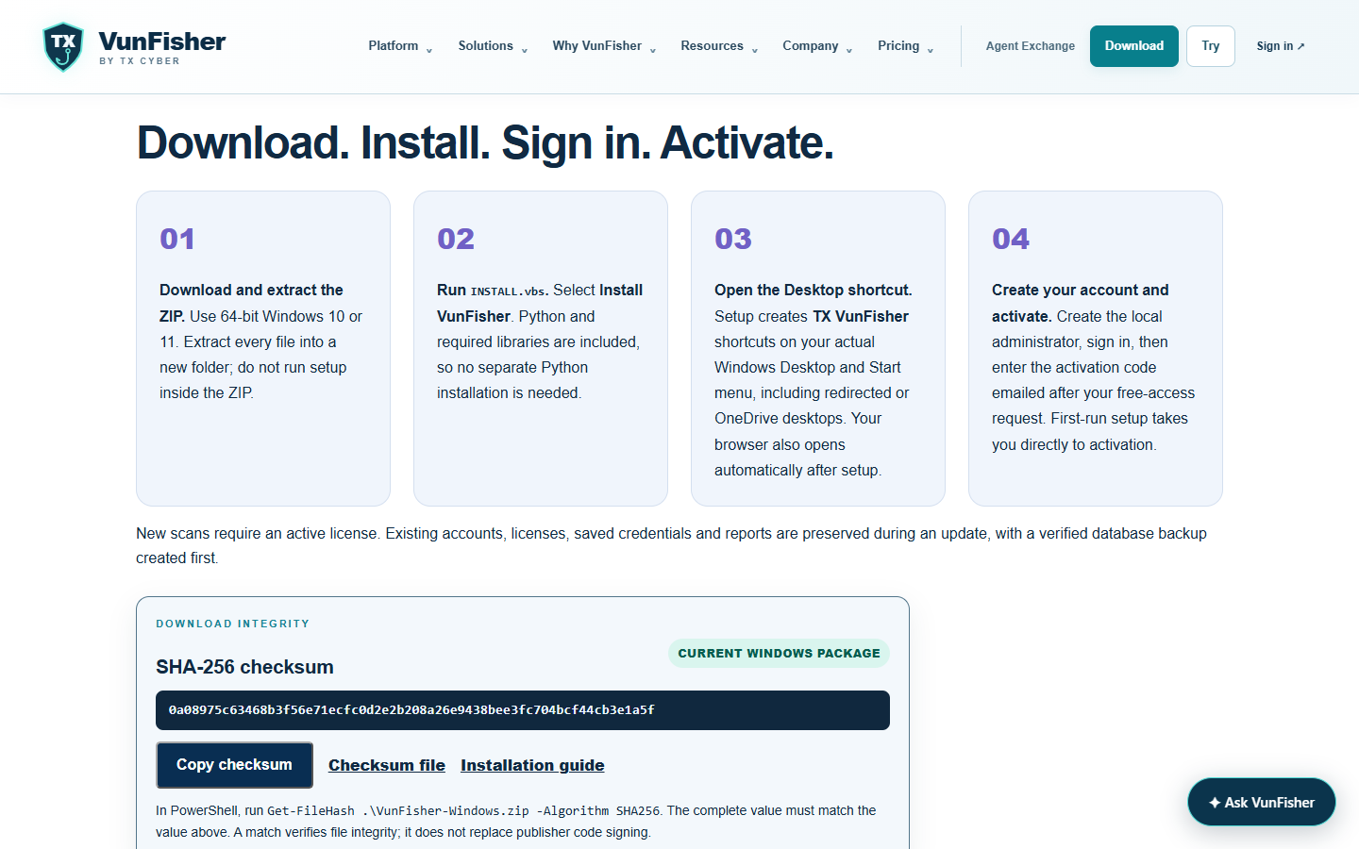
Controlled beta tester workflow
Use the complete walkthrough on the download page and assess only explicitly authorized systems
1 Request free access and verify the Windows package
2 Install and open the Desktop shortcut
3 Create the local scanner administrator at 127.0.0.1:8787
4 Activate, scan the MFA QR code and save recovery codes
5 Restart and confirm the account, license and MFA persist
6 Choose a local or credentialed remote Windows test
7 Audit the authorized target and resolve every STOP item
8 Create the WinRM profile, load the password and test access
9 Run the scan and verify authentication, evidence and coverage
10 Record action, retest, export a report and send redacted feedback
Local and hosted accounts are separate. Keep target passwords only in the installed app's protected credential flow.
TX Cyber / VunFisher · Controlled beta
07
Notes:
Tester process matches BETA_TESTER_INVITATION_EMAIL.md, TESTER-START-HERE.txt and the complete VunFisher Tester Walkthrough.

Slide 8
Evidence required from the beta
The business position remains a hypothesis until customers demonstrate the outcome
Problem
Most qualified interviewees describe evidence and closure fragmentation without prompting
Completion
At least four of five observed testers complete the core workflow
Trust
Authentication, coverage and finding rationale are understandable
Reporting
Security, IT and audit reviewers can use an export with little reconstruction
Economics
Qualified organizations show credible paid-pilot intent and support cost is sustainable
North-star outcome
Actionable findings that reach a documented, retested disposition while retaining their evidence chain
TX Cyber / VunFisher · Controlled beta
08
Notes:
Validation targets are hypotheses from VUNFISHER_LEAN_A3_PRODUCT_STRATEGY.md. They may change after customer interviews.

Slide 9
Official links and tester resources
Click any link while viewing the PowerPoint
Main website
Capabilities and roadmap
https://txvf.tinkextra.com/overview/
https://txvf.tinkextra.com/overview/roadmap.html
Why VunFisher
Beta feedback
https://txvf.tinkextra.com/overview/why-vunfisher.html
https://txvf.tinkextra.com/overview/beta-feedback.html
Download and installation
Platform sign in
https://txvf.tinkextra.com/overview/downloads.html
https://txvf.tinkextra.com/login
Resources and advisories
https://txvf.tinkextra.com/overview/resources.html
Authorized testing only
Assess only systems and networks you own or have explicit permission to test.
TX Cyber / VunFisher · Controlled beta
09
Notes:
Public URLs are VunFisher official links. Competitive context sources: https://www.tenable.com/products/vulnerability-management and https://docs.rapid7.com/insightvm/remediation-workflow/. Lean methods: https://draft.io/example/lean-startup-canvas and https://www.pmi.org/learning/library/lean-fast-using-a3-save-program-9270.

