Slide 1
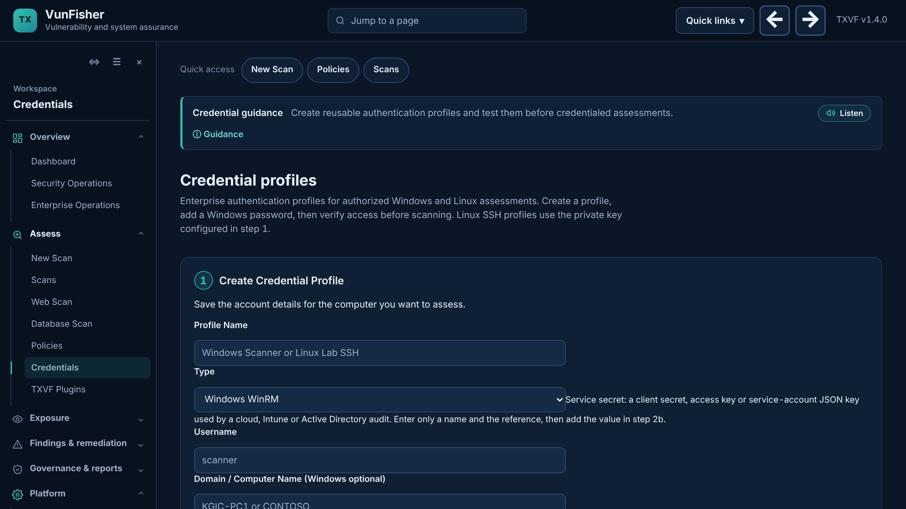
VunFisher credentialed scanning
Prepare Windows and Linux targets with or without the Target Setup Assistant, and run your first credentialed scan
Notes:
Training session. Every student needs VunFisher installed with an active license (see the deck "VunFisher: request and install"). Scan only computers you own or that your instructor has authorized in writing.

Slide 2
Before the training
1
VunFisher installed and active
Platform > License shows ACTIVE (request and install deck)
2
Two computers on the same network
The scanner (runs VunFisher) and a target: a lab VM or a second PC
3
Administrator rights on the target
To turn on remote management and create a scan account
4
Written authorization
Only scan computers you own or your instructor has approved
Two ways to prepare a Windows target: the Target Setup Assistant (Part 1, easiest) or by hand (Part 2, also covers Linux).
Notes:
Lab suggestion: two virtual machines on a VMware or VirtualBox host-only network, for example scanner 192.168.56.10 and target 192.168.56.20.

Slide 3
Part 1: Prepare a Windows target with the assistant
Target Setup Assistant 0.3.0, run on the computer you will scan

Slide 4
Scanner and target: who does what
Scanner computer
Runs VunFisher
Holds the scan account password
Target computer
Runs the Target Setup Assistant
Allows only the scanner to connect
Windows Remote Management, port 5985
The assistant never asks for, shows or stores a password. You type the scan account password only in VunFisher on the scanner.
Notes:
For a first class, the scanner and target can be two virtual machines on the same host network, or a student laptop and a lab VM. Never point it at computers outside the authorized lab.

Slide 5
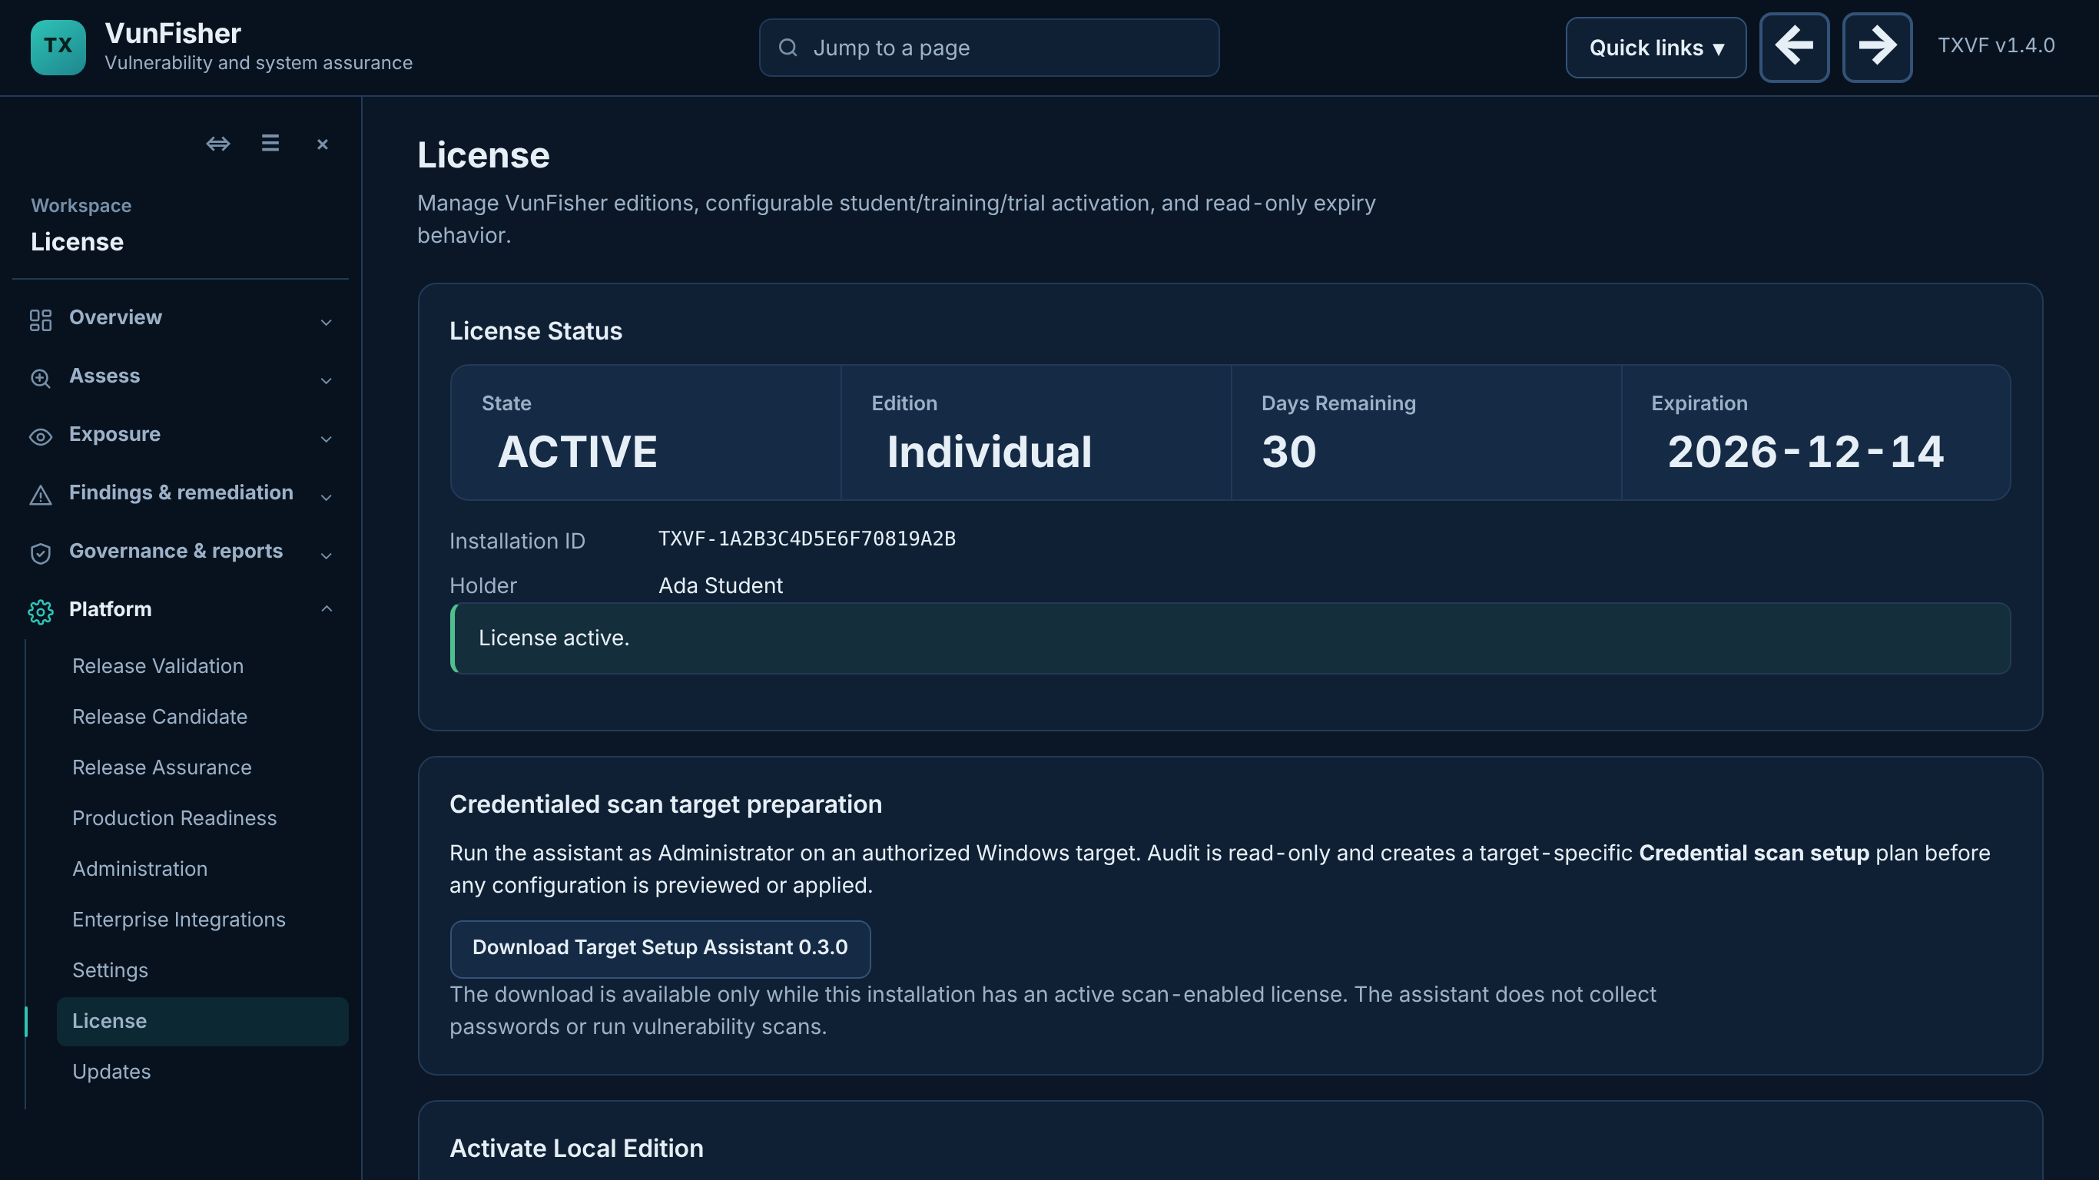
Get and start the Target Setup Assistant
1
Download it
VunFisher > Platform > License > Download Target Setup Assistant 0.3.0
2
Copy the ZIP to the target computer
USB drive or shared folder
3
Extract All on the target
Then double-click Start-Assistant.cmd
4
Approve the Windows prompt
The assistant needs administrator rights on the target
Notes:
The download appears only while the license is active. INSTALL.cmd is optional: it copies the assistant to the profile and adds a desktop shortcut.

Slide 6
The assistant walks you through five steps
Check this computer
Reads network type, remote management and firewall. Changes nothing. Fix any STOP line first.
1
Scanner and account
Scanner IPv4 address (run ipconfig on the scanner) and the scan account, e.g. PC-NAME\vfscan.
2
Preview the changes
Shows exactly what will change. Nothing has changed yet.
3
Apply the changes
After you approve. A checkpoint folder is saved; keep its path for Undo.
4
Connect VunFisher
Shows the exact credential settings to enter on the scanner.
5
Notes:
No scan account yet? On the target, in an administrator Command Prompt: net user vfscan * /add then net localgroup Administrators vfscan /add. Windows asks for the new password; it is never typed into the assistant. Home editions of Windows and Public networks are not supported: the assistant stops and says why.

Slide 7
On the scanner: create and test the credential
1
Open Credentials
Left menu: ASSESS > Credentials
2
1 Create Credential Profile
Windows WinRM, user, computer name, 5985, reference TXVF_LAB_PASSWORD
3
2 Add Windows Password
Pick the profile and type the password
4
3 Test Connection
Target address + profile > Test Credential; every stage should pass
5
Then scan
New Scan > Credentialed Windows Assessment > select the profile
Notes:
If Test Connection fails, the result names the failing stage: secret, connectivity, sign-in, identity or privilege. Connectivity usually means the scanner IP typed in the assistant was wrong.

Slide 8
Part 2: Prepare targets by hand
Prepare Windows and Linux targets by hand, the way scanner guides such as Nessus describe it
Notes:
Use this part when the Target Setup Assistant cannot run (Windows Home, policy-managed computers, Linux targets) or when students should understand what the assistant does. Example addresses on the following slides: scanner 192.168.56.10, Windows target 192.168.56.20 named LAB-PC1, Linux target 192.168.56.30. Replace them with your lab addresses.

Slide 9
What a credentialed scan needs
 | Nessus (for comparison) | VunFisher
Windows connection | SMB (445) and WMI; Remote Registry and admin shares | Windows Remote Management (WinRM), TCP 5985, PowerShell remoting with Negotiate sign-in
Windows account | Administrator-level account | Administrator-level account (local or domain)
Local accounts | Remote UAC setting (LocalAccountTokenFilterPolicy) | Same setting, only for local accounts, and only when needed
Linux | SSH with a password or key; often sudo | SSH with a key; no sudo needed (reads the installed package list)
Where the password goes | Scan policy credentials | Credentials page on the scanner; never on the target
VunFisher does not need Remote Registry, admin shares or SMB for credentialed Windows checks: leave those as they are.
Notes:
Sources: Tenable "Credentialed Checks on Windows" and Microsoft PowerShell remoting documentation (links on the last slide). The comparison describes setup requirements only; it does not claim the same detection coverage as Nessus.

Slide 10
Windows target, by hand (1 of 2)
On the target: open Windows PowerShell as administrator
# 1. A scan account (Windows asks for the new password; type it there only)
net user vfscan * /add
net localgroup Administrators vfscan /add
# 2. The network must be Private (or Domain), not Public
Get-NetConnectionProfile
Set-NetConnectionProfile -InterfaceAlias "Ethernet" -NetworkCategory Private
# 3. Turn on Windows Remote Management (WinRM, port 5985)
Enable-PSRemoting -Force
Domain computers: skip step 1 and use a domain scan account in a group that is a member of the local Administrators group.
Notes:
Replace "Ethernet" with the InterfaceAlias that Get-NetConnectionProfile shows. Windows Home editions cannot accept WinRM connections from a local account in a supported way; use Pro, Enterprise or Education. Never type the password into a script, chat or screenshot.

Slide 11
Windows target, by hand (2 of 2)
Still on the target, as administrator
# 4. Let only the scanner reach WinRM
Set-NetFirewallRule -Name WINRM-HTTP-In-TCP -RemoteAddress 192.168.56.10
Disable-NetFirewallRule -Name WINRM-HTTP-In-TCP-PUBLIC
# 5. Local accounts only (workgroup lab): allow remote admin rights
New-ItemProperty -Path HKLM:\SOFTWARE\Microsoft\Windows\CurrentVersion\Policies\System `
-Name LocalAccountTokenFilterPolicy -Value 1 -PropertyType DWord -Force
# 6. Check that WinRM answers
Test-WSMan localhost
Step 5 lowers a Windows protection for local accounts. Use it only on lab computers, and remove it after the course (Undo slide).
Notes:
Step 4 limits the built-in WinRM firewall rule to the scanner address. If several scanners are approved, list them separated by commas. Step 5 is what Microsoft calls UAC remote restrictions; domain accounts do not need it.

Slide 12
On the scanner: trust the target and test
On the computer running VunFisher: Windows PowerShell as administrator
# 1. Is port 5985 reachable?
Test-NetConnection 192.168.56.20 -Port 5985
# 2. Workgroup or IP address targets only: trust this one target
Start-Service WinRM
Set-Item WSMan:\localhost\Client\TrustedHosts -Value '192.168.56.20' -Concatenate -Force
# 3. Sign in once by hand (a password prompt opens)
Invoke-Command -ComputerName 192.168.56.20 -Credential LAB-PC1\vfscan -ScriptBlock { whoami }
If step 3 prints lab-pc1\vfscan, VunFisher will be able to sign in too. Domain targets addressed by name do not need TrustedHosts.
Notes:
TrustedHosts is a list on the scanner of computers it may sign in to with NTLM. Keep it to the exact lab targets; never use the * wildcard. VunFisher itself never changes TrustedHosts.

Slide 13
In VunFisher: the Windows credential
1
ASSESS > Credentials > 1 Create Credential Profile
Type Windows WinRM; Username vfscan; Domain / Computer Name LAB-PC1; Port 5985; Secret reference TXVF_LAB_PASSWORD
2
2 Add Windows Password
Select the profile, type the password. Tick DPAPI remember only on your own computer.
3
3 Test Connection
Target 192.168.56.20, the profile, the authorization box > Test Credential
4
New Scan
Credentialed Windows Assessment or Credentialed Patch Audit > select the profile
Notes:
The reference name is a label, not the password. Use one reference per account, for example TXVF_LAB_PASSWORD. Passwords are never stored in the VunFisher database or reports; DPAPI remembers them encrypted for the current Windows user on this computer only.

Slide 14
Linux target over SSH
On the scanner (Windows PowerShell)
On the Linux target (Ubuntu, Debian or Alpine)
# A key for VunFisher
$k = "$env:USERPROFILE\.ssh\vunfisher_ed25519"
ssh-keygen -t ed25519 -f $k
# Show the public key to copy
Get-Content "$k.pub"
# Test after the target is ready
ssh -i $k vfscan@192.168.56.30 id
sudo useradd -m -s /bin/bash vfscan
sudo install -d -m 700 -o vfscan -g vfscan /home/vfscan/.ssh
# paste the .pub line into this file:
sudo nano /home/vfscan/.ssh/authorized_keys
sudo chown vfscan:vfscan /home/vfscan/.ssh/authorized_keys
sudo chmod 600 /home/vfscan/.ssh/authorized_keys
sudo ufw allow from 192.168.56.10 to any port 22 proto tcp
1
VunFisher > Credentials > 1 Create Credential Profile
Type Linux SSH; Username vfscan; Port 22; SSH Private Key Path C:\Users\you\.ssh\vunfisher_ed25519
2
Test Connection, then New Scan
Credentialed Linux Assessment > select the profile. No sudo and no password are needed.
Notes:
VunFisher signs in without prompts, so a key protected by a passphrase must be loaded into the Windows ssh-agent first (ssh-add). For a lab, a key without a passphrase is acceptable if it is deleted after the course. On Alpine use adduser instead of useradd. The first connection records the target host key.

Slide 15
Many computers: domain and Intune
1
Create a scan group
Add the approved domain scan account; test on one OU with one or two computers first
2
Add the group to local Administrators
Group Policy Preferences > Local Users and Groups (add, do not replace the list)
3
Turn on WinRM by policy
Computer Configuration > Administrative Templates > Windows Components > Windows Remote Management
4
Firewall rule for TCP 5985
Domain and Private profiles; remote addresses = approved scanners only
5
Check and widen slowly
gpresult /r on a target, Test Connection in VunFisher, then more OUs. Intune: the same settings in Settings Catalog profiles
Domain accounts do not need the LocalAccountTokenFilterPolicy setting. Do not add domain controllers until IT has reviewed them.
Notes:
The Target Setup Assistant guide (guide.html in the assistant ZIP) has the full Group Policy and Intune procedures, troubleshooting and rollback.

Slide 16
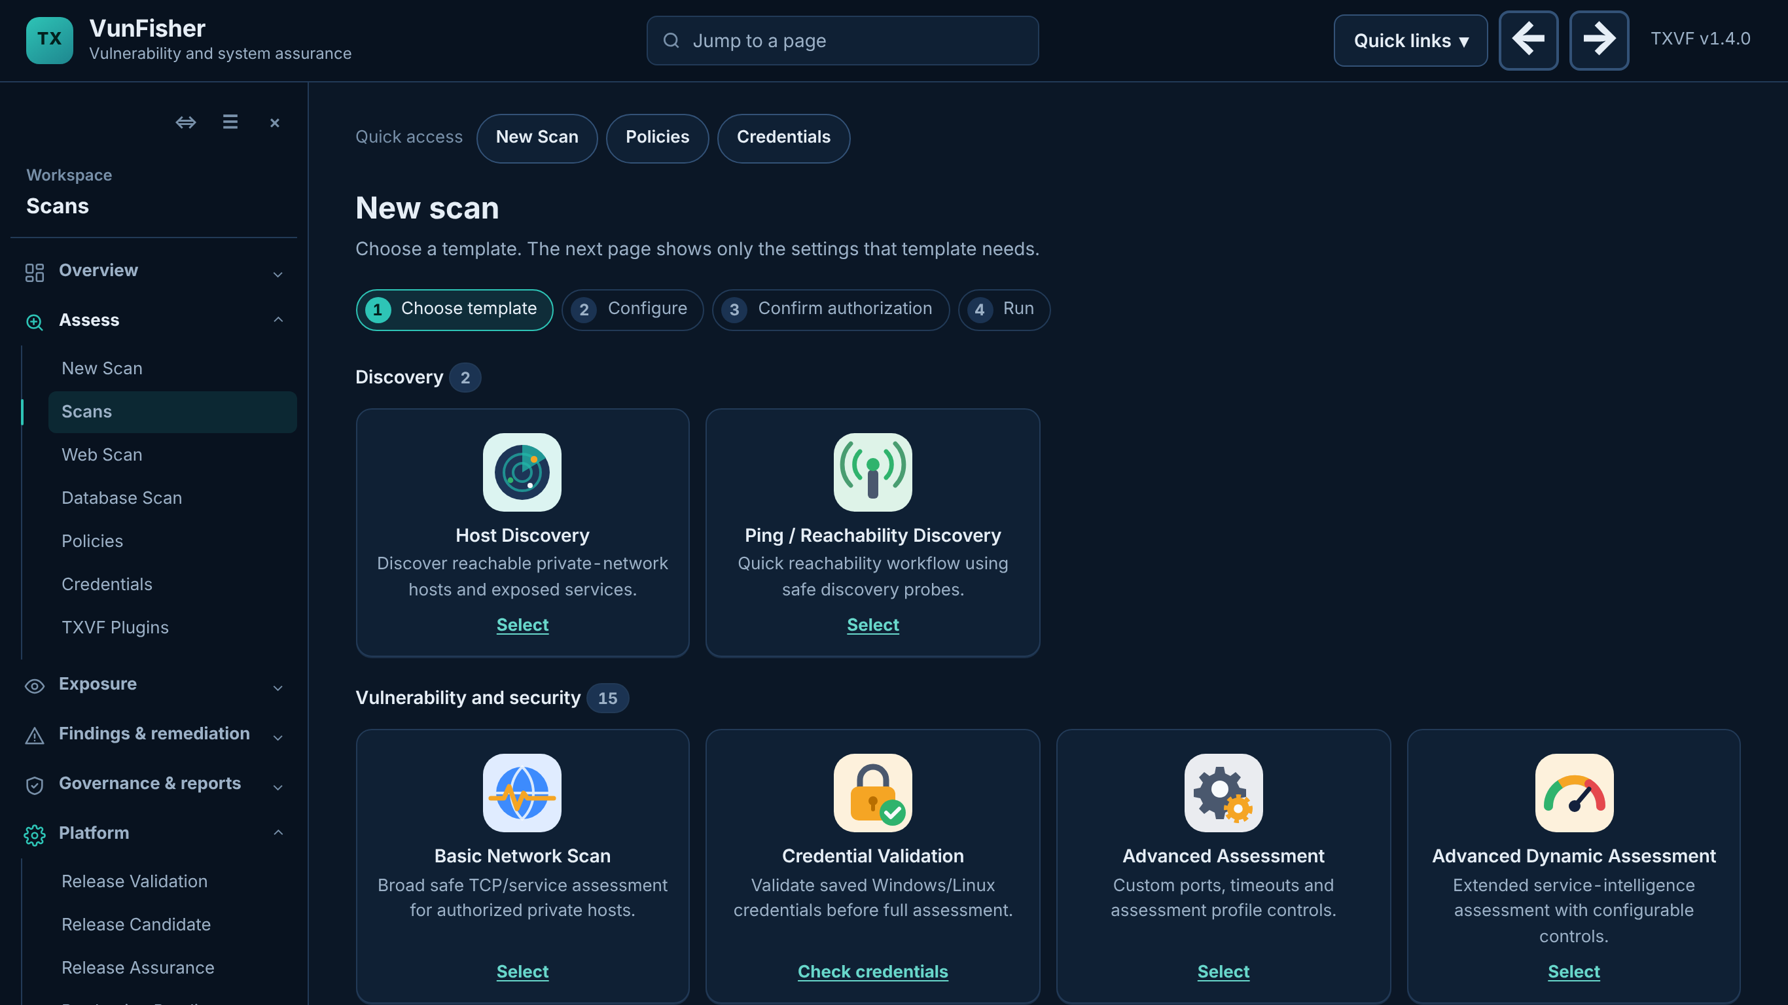
Run your first scan
New Scan
Choose Credentialed Windows Assessment (or Credentialed Linux Assessment)
Enter the authorized target address and select the credential profile
Confirm authorization and run
Open Findings when it completes; Explain with AI gives a plain-English summary of a finding
Notes:
Explain with AI becomes available once TX Cyber has enabled AI answers on the server.

Slide 17
Undo after the course
Windows target (administrator PowerShell)
Scanner and Linux target
Disable-PSRemoting -Force
Disable-NetFirewallRule -Name WINRM-HTTP-In-TCP
Stop-Service WinRM
Set-Service WinRM -StartupType Manual
Remove-ItemProperty -Path `
HKLM:\SOFTWARE\Microsoft\Windows\CurrentVersion\Policies\System `
-Name LocalAccountTokenFilterPolicy
net user vfscan /delete
# Scanner: empty TrustedHosts again
Set-Item WSMan:\localhost\Client\TrustedHosts `
-Value '' -Force
# VunFisher: Credentials > Clear secret,
# then Disable the profile
# Linux target:
sudo userdel -r vfscan
sudo ufw delete allow from 192.168.56.10 \
to any port 22 proto tcp
If TrustedHosts listed other computers before the course, remove only the lab entries instead of emptying it. Delete the vunfisher_ed25519 key files on the scanner too.
Notes:
Disable-PSRemoting alone does not stop the service or remove the firewall exception, which is why the extra commands are listed.

Slide 18
Quick fixes
Test Credential: connectivity fails
Firewall rule or scanner address. Run Test-NetConnection target -Port 5985 on the scanner.
Test Credential: sign-in fails
Check the account name (COMPUTER\user), the password in step 2 and TrustedHosts for IP targets.
Signed in but not administrator
Add the account to local Administrators; local accounts also need LocalAccountTokenFilterPolicy.
Assistant shows STOP
Public network, Windows Home or a policy-managed computer: fix it or prepare the target by hand.
Linux: permission denied
Check authorized_keys permissions (600) and the key path in the profile.
Scan shows coverage gaps
A check could not collect evidence. Read the reason; it is not a clean result.
Notes:
Keep this slide on screen during the hands-on part.

Slide 19
Links you will need
VunFisher
VunFisher website: https://txvf.tinkextra.com/overview/
Downloads (app, hash, SBOM): https://txvf.tinkextra.com/overview/downloads.html
Student license request: https://txvf.tinkextra.com/quote?for=student
Every published build: https://txvf.tinkextra.com/overview/roadmap.html#release-history
Your local app (after install): http://127.0.0.1:8787/credentials
Microsoft
Enable-PSRemoting (PowerShell 5.1): https://learn.microsoft.com/en-us/powershell/module/microsoft.powershell.core/enable-psremoting?view=powershell-5.1
Remote troubleshooting, TrustedHosts: https://learn.microsoft.com/powershell/module/microsoft.powershell.core/about/about_remote_troubleshooting
WinRM security: https://learn.microsoft.com/en-us/powershell/scripting/security/remoting/winrm-security
New-NetFirewallRule: https://learn.microsoft.com/powershell/module/netsecurity/new-netfirewallrule
UAC remote restrictions (local accounts): https://support.microsoft.com/help/951016
OpenSSH keys on Windows: https://learn.microsoft.com/en-us/windows-server/administration/openssh/openssh_keymanagement
Nessus, for comparison
Credentialed checks on Windows: https://docs.tenable.com/nessus/Content/CredentialedChecksOnWindows.htm
SSH credentials: https://docs.tenable.com/nessus/Content/SSH.htm
Notes:
Share these links in the course chat. The Target Setup Assistant ZIP (Platform > License in the app) also contains guide.html with Group Policy, Intune and rollback procedures.

Slide 20
You are ready to scan
Target prepared · credential tested · first scan run · undo the lab changes when the course ends
Notes:
Collect questions. Remind students to run the Undo steps (or the assistant Undo) on lab computers after the course.

